Slide 1



DATA CLEANING USING EXCEL
https://shorturl.at/gGKOT

Slide 2

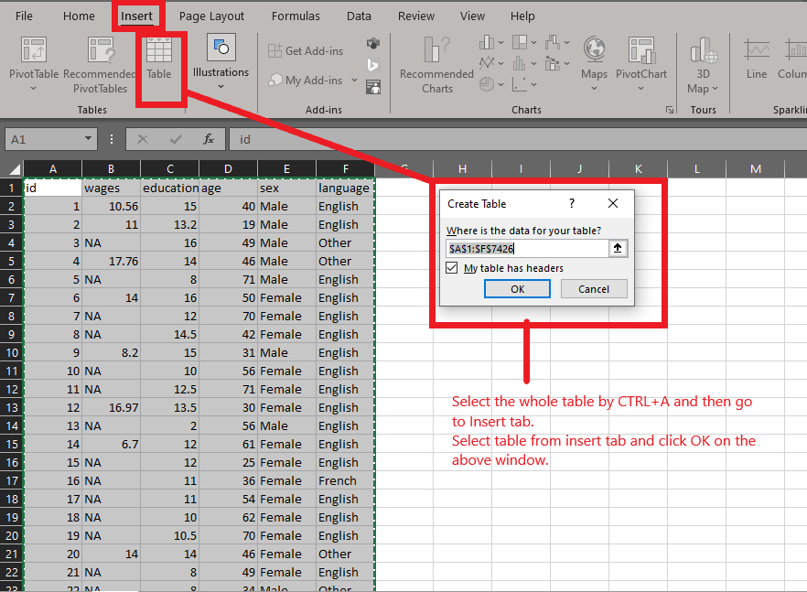
STEP: 1
Convert the whole data into table (this will help you later while dealing with columns and pivot tables).

Slide 3




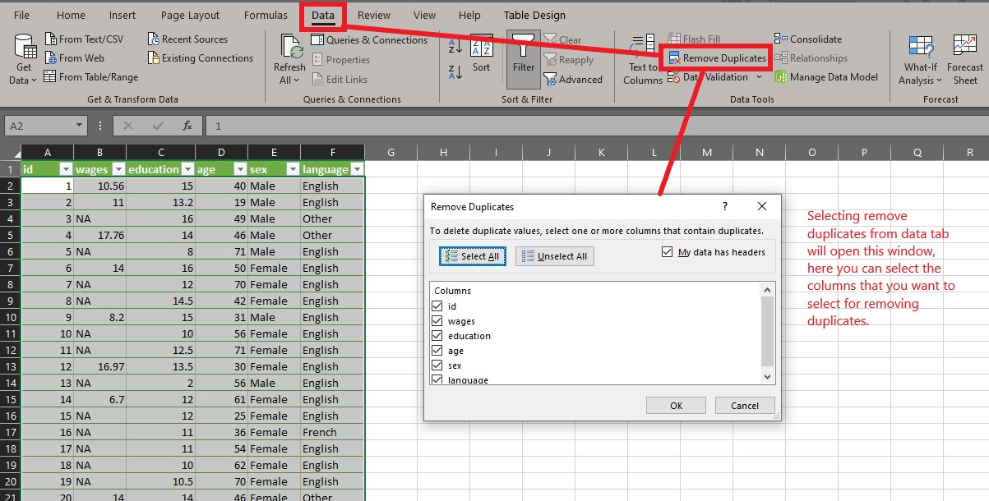
Remove duplicates:
Remove duplicates:
https://shorturl.at/gGKOT

Slide 4


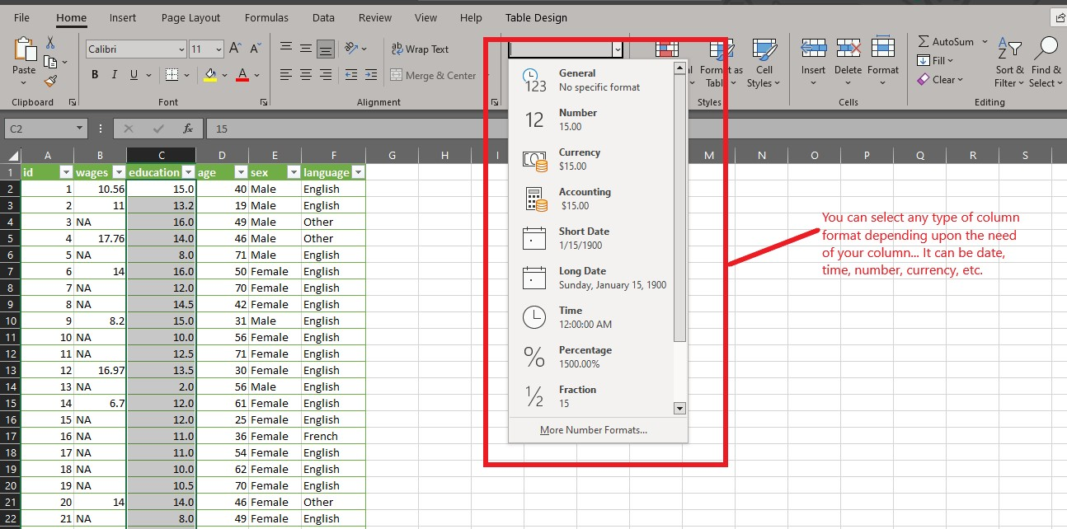

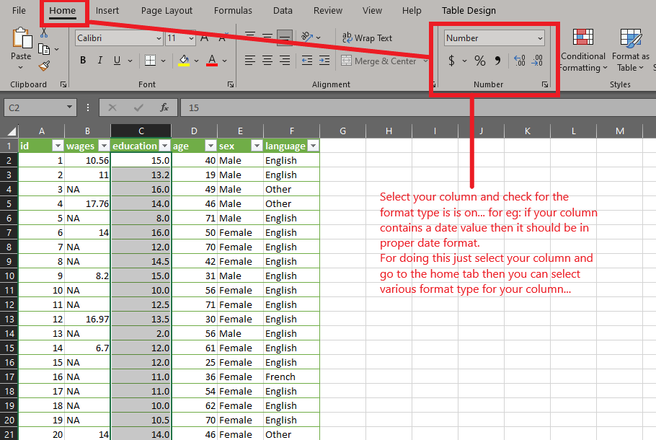
Selecting proper column type or
formatting column in desired type:
https://shorturl.at/gGKOT

Slide 5


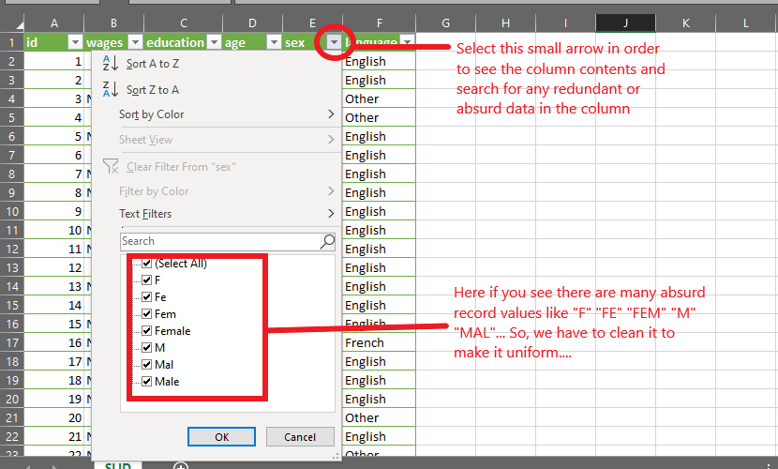

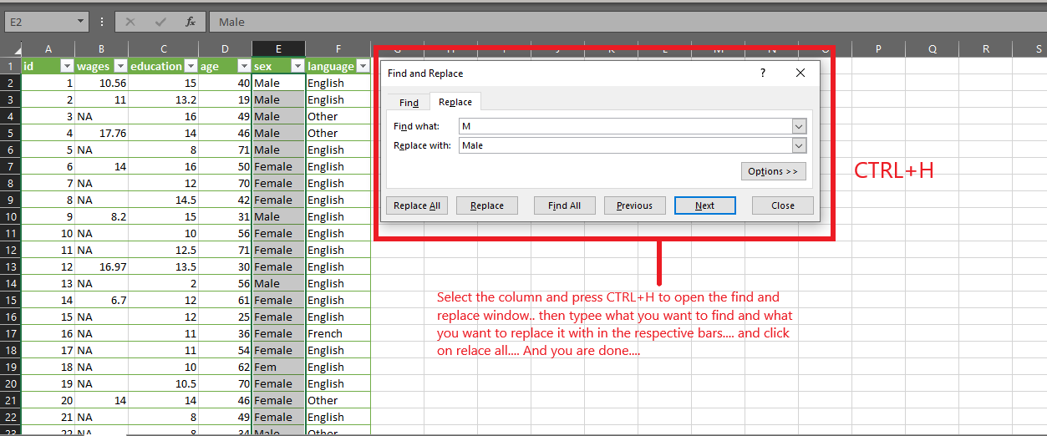
Find and replace:
https://shorturl.at/gGKOT

Slide 6
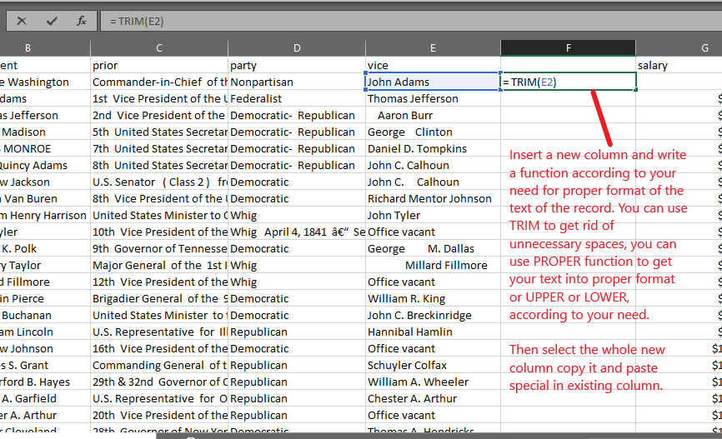
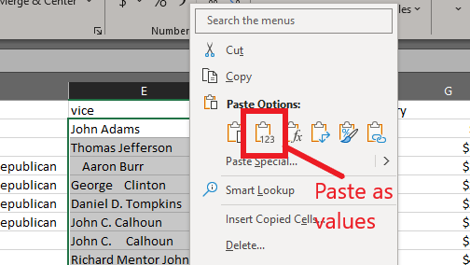
STEP: 5
Formatting column content in proper text format, and getting rid of the unnecessary spaces in between the content of records.
Paste as values :
https://shorturl.at/gGKOT

Slide 7
STEP: 6
Handling NA/ NULL values:
Case 1: If there are only a few records (Compared to your dataset) that have NULL values or no values, then just delete those rows.
Case 2: If there are many null records in a column and that column does not contribute much in your analysis part then delete the whole column.
Case 3: If there are many null records in your column and that column also plays a vital role in the analysis then try to fill those records accordingly. For this you can substitute the Null values using central tendencies like median or interpolation values, etc. Further for text you can fill those with a text that is uniform like “None” or “Not interested”, “Others”, etc.
https://shorturl.at/gGKOT

Slide 8

Thank you
https://shorturl.at/gGKOT

